Slide 1



Movie Recommendation System: Exploring Movie Data Using Cosine Similarity
Discover the power of data-driven movie recommendations using cosine similarity. Uncover hidden gems and make informed choices.
Supervised By:
Shubham Singhal
Submitted By:
Pranav Bansal 2210990665
Pratyukt Nag 2210990679
Raghav Kaushal 2210990699
Raghav Nagi 2210990700

Slide 2

Introduction
This project explores the power of data-driven movie recommendations using cosine similarity. By analyzing a comprehensive movie dataset, we aim to uncover hidden gems and empower users to make more informed choices about their next viewing experience.
Data Preprocessing
Imported key libraries: NumPy, Pandas, Matplotlib, Scikit-learn, NLTK
Loaded the movie_dataset.csv dataset from its source
Handled missing values through imputation and data cleaning techniques
Performed feature engineering to create derived attributes like metascore

Slide 3

Exploratory Data Analysis
Dive into the movie dataset, uncovering insights through visualizations and statistical analysis.

Slide 4



Feature Engineering and Data Preparation
Feature Engineering
Data Preparation
Cosine Similarity Calculation
To enhance the recommendation system, we engineered new features from the raw data, such as creating a 'metascore' attribute that combines critics' reviews.
The team carefully preprocessed the movie dataset, handling missing values, removing duplicates, and transforming the data to be ready for analysis.
We used the powerful cosine similarity algorithm to quantify the relationships between movies based on their textual features, enabling us to find the most similar titles.

Slide 5
Evaluation and Metrics
1
Accuracy
2
User Satisfaction
Measure recommendation precision and recall
Conduct surveys and gather feedback

Slide 6
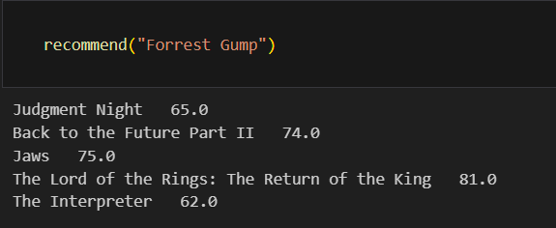
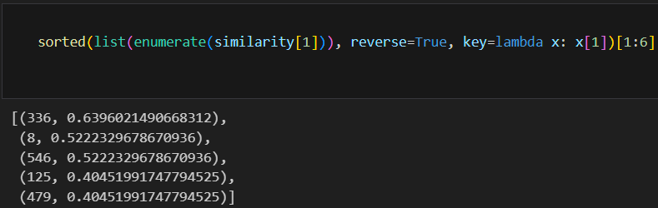
Cosine Similarity Calculation
Computed cosine similarity between movie feature vectors to identify similar movies.
Cosine similarity scores highlight the importance of genre and plot summary in determining movie similarity.

Slide 7
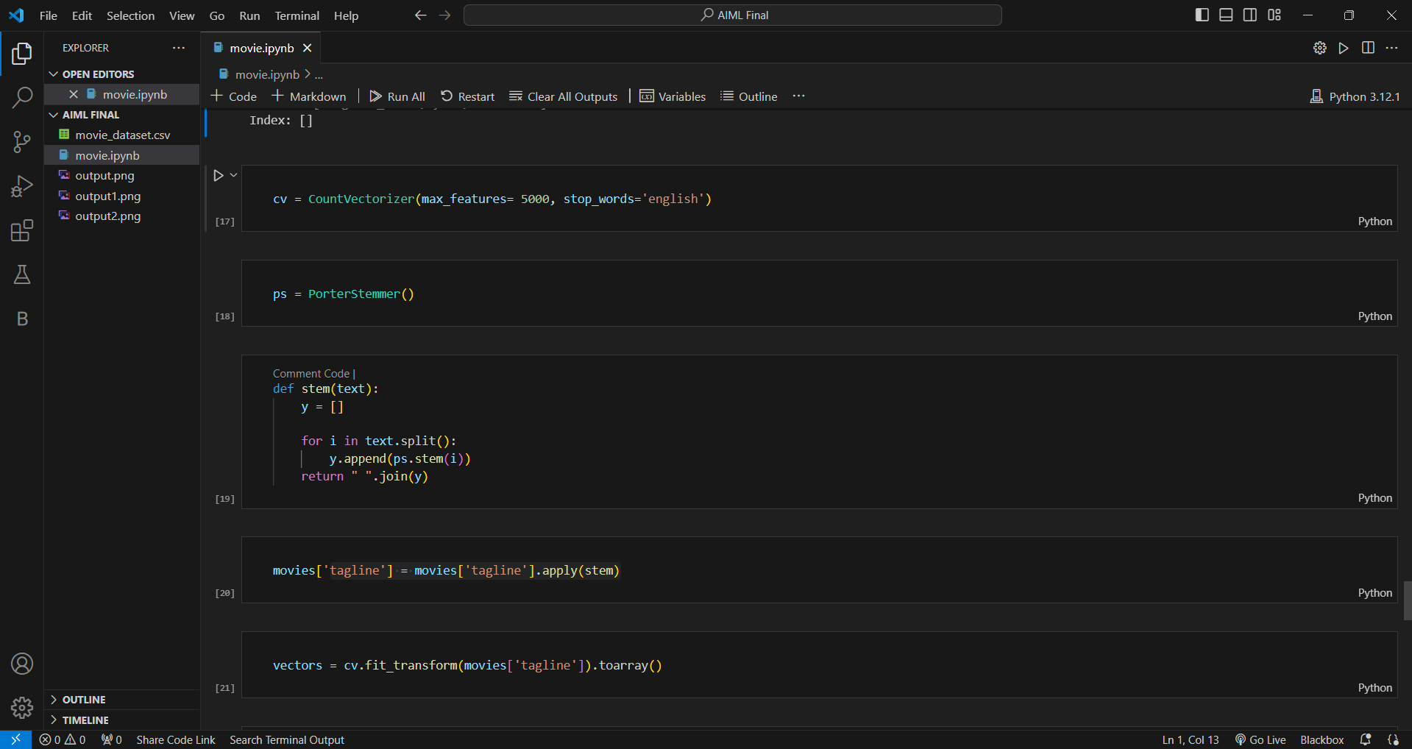
Explaining the Code for the Movie Recommendation System
To bring our movie recommendation system to life, we leveraged a powerful combination of data preprocessing, feature engineering, and the cosine similarity algorithm. This technical approach allowed us to uncover meaningful connections between movies and deliver personalized recommendations to users.

Slide 8
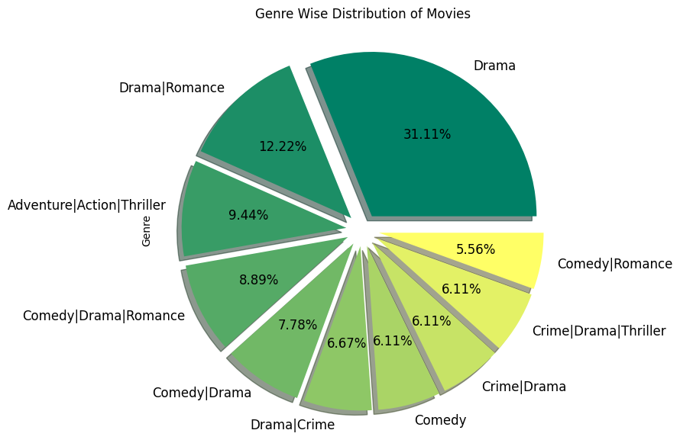
Data Analysis

Slide 9
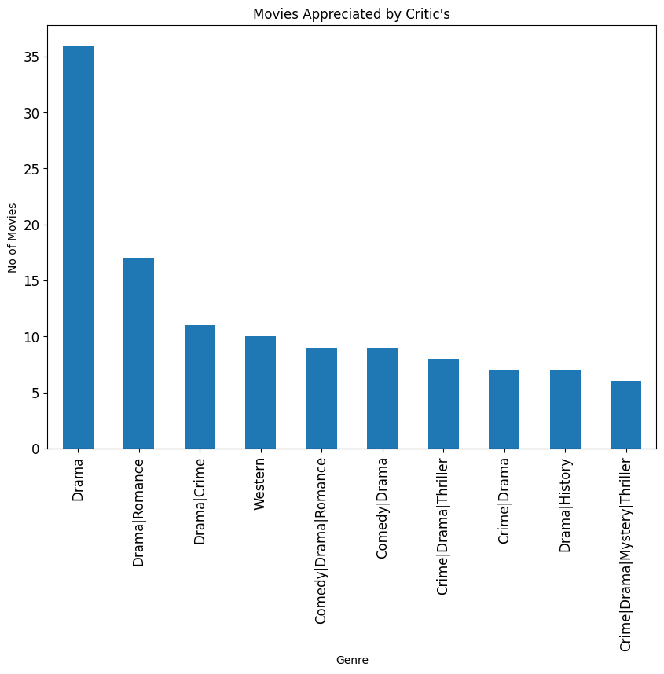

Slide 10
Limitations and Future Improvements
Data Limitations
Algorithm Improvements
Biased ratings
Enhance similarity models, Added graphs for better visual understanding
User Experience
Scalability
Personalized recommendations
Handle growing movie database, increase processing capacity

Slide 11
THANK YOU
We appreciate you taking the time to explore our movie recommendation system. Thank you for your interest and valuable feedback.

